Slide 1

TOPIC:
Exposition into DATA ANALYSIS

Slide 2
OUTLINE
UNDERSTANDING DATA ANALYSIS
What is Data Analysis
Distinction Between Data Analysis and Data Analytics
Who is a Data Analyst
The Role and Responsibilities of a Data Analyst
Why is Data Analysis Important
Types of Data
Five steps to data analysis
Tools & Software needed in data analysis
Employers of data analysts

Slide 3

WHAT IS DATA ANALYSIS
Data analysis involves systematically applying statistical and logical techniques to describe, condense, and evaluate data. It aims to uncover useful information, draw conclusions, and support decision-making.

Slide 4
DISTINCTION BETWEEN DATA ANALYSIS AND DATA ANALYTICS
Data Analysis is the process of examining data sets to find trends and draw conclusions.
Data Analytics encompasses the technologies and processes used to perform analysis and also involves predictive modeling and data visualization to inform decision-making.

Slide 5

WHO IS A DATA ANALYST
A data analyst is a professional who collects, processes, and performs statistical analyses on large datasets. They help organizations make data-driven decisions by interpreting and presenting the data in a clear and actionable way.

Slide 6
The Role and Responsibilities of a Data Analyst
Problem Identification and Statements of Objectives
1
Gathering Data, Cleaning and Organizing Data
2
Analyzing data to find trends and patterns
3
Creating Visualizations & Report of Data
4
Presenting Findings to Stakeholders for Decision Making
5

Slide 7
Why is Data Analysis Important
Data analysis is important because it helps organizations make informed decisions
Helps in identifying opportunity for growth and competitive edge in business
Help in understanding customer or target audience’s reason for behaviors
It enhances productivity and record keeping
It help in predicting future trends

Slide 8
Types of Data
Qualitative Data: It is a descriptive data that can be observed but not measured in real time e.g customer review or data gotten by interviewing people
Quantitative Data: This numerical in nature. They can be measured and counted e.g Sales figure, number of church members, Temperature
Structured Data: The type already made and gotten from a fixed data base
Unstructured Data: This type lack a predefined format e.g Data gotten from Social media ,emails and videos

Slide 9
Five Steps to Data Analysis
Define the Objective: Determine what you want to achieve with your analysis e.g what is the business or human problem I am trying solve?
1
Collect Data: Gather relevant data from various sources
2
Clean and Organize Data: Remove or errors and irrelevant data in preparation for the analysis
3
Analyze Data: Use various tools ,statistics and software to analyze the data
4
Interpret and present result: The can be achieved by using visualization and presentation Metrix and tools.
5

Slide 10

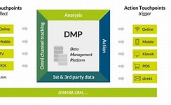



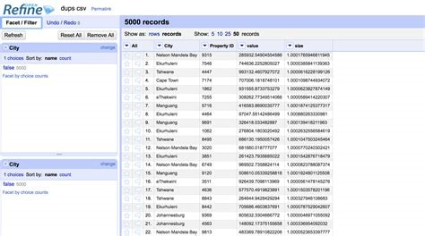
TOOLS FOR DATA CLEANING:

Slide 11



TOOLS FOR ANALYZING DATA:

Slide 12
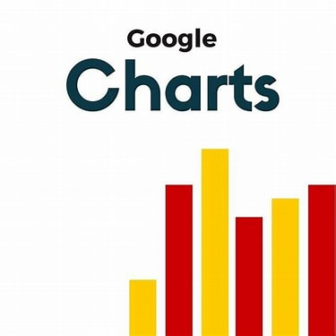
TOOLS FOR VISUALIZATION,PRESENTATION AND SHARING OF RESULTS:

Slide 13
Employers of Data Analysts
higher education institutions.
retail companies.
professional services firms.
insurance companies.
marketing firms.
pharmaceutical companies.
telecommunications companies.
information technology firms.
Government parastates EFCC,CENSOR,MINISTRY OF FINANCE,HEALTH FBI
Entrepreneurs/Sole proprietorship.
Religious Body e.g Church, Agricultural body, FMCGS

Slide 14
THE END presenter: Akinwale akintayo
Thank you for your time

